Slide 1
Parson’s Programming Puzzles:
Optimizing Efficiency and Investigating
the Effects of Feedback
Further research on Social Addictive Gameful Engineering (SAGE) design
and computational thinking (CT)
Spring 2021
Alexander Liebeskind
Research Proposal

Slide 2
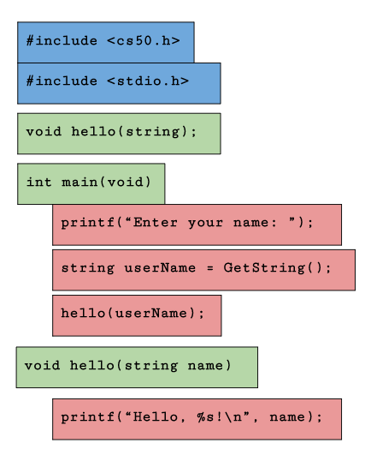

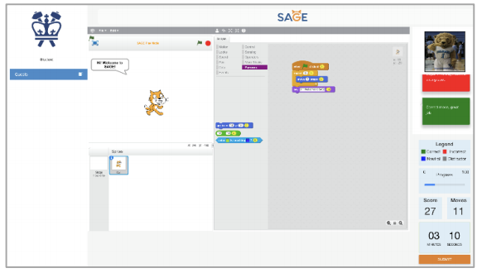
Background
Parson’s Programming Puzzles
Scratch
SAGE
Notes:
Background:
Field study 1 (fs1) was recently completed, written up, and submitted for publication (Integrating Parsons Programming Puzzles with Scratch), which explored cognitive load, performance, efficiency, and motivation across PPP conditions
These findings support the hypothesis that (1) PPP and PPP with distractors training increases motivation and
reduce extraneous cognitive load (as compared to limited constraint and feedback), but refute the hypothesis (2) PPP training yields the highest learning efficiency.
Research Aims:
Extend upon prior investigation of Social Addictive Gameful Engineering (SAGE) and computational thinking (CT) by completing field study 2 (fs2)
Field study 2 (fs2) is underway - data collection has just been completed
Preprocessing, analysis, and write-up have not yet begun
Stretch goal: fs3 design and execution

Slide 3
Related Work
Parson’s Programming Puzzles: A Fun and Effective Learning Tool for First Programming Courses
Lessons Learned from Available Parsons Puzzles Software
Measuring Cognitive Load in Introductory CS: Adaptation of an Instrument
Notes:
Parson’s Programming Puzzles: A Fun and Effective Learning Tool for First Programming Courses
Established original Parson’s Programming Puzzles and key aims (maximize the engagement, constrain the logic, permit common errors, model good code, and provide immediate feedback)
Lessons Learned from Available Parsons Puzzles Software
Researched PPP implementations ( Hot Potatoes Implementation, JS-Parsons, Epplets, and EvoParsons) and determined ideal PPP constraints
Measuring Cognitive Load in Introductory CS: Adaptation of an Instrument
Established metrics for cognitive load and introduced cognitive load theory (working memory constraint)

Slide 4
Aims of fs2
fs1 Validation
Novel Findings
Notes:
1. Corroborate the findings of fs1
Confirm solutions
2. Novel findings
9 groups (control group, 4 feedback, 4 non feedback)
Generalizability
More groups -> more defined/nuanced results
Fs1 involved 75 participants spread across 3 condition groups, while the sample in fs2 is comprised of 662 participants (estimated based on trends in MTurk and Prolific) across 9 total groups (including a control group).

Slide 5
Timeline
Relevant Statistics and Graphical Methods
Data Timing and Correctness Preprocessing
Writing, Editing, and Submission
Data Extraction
Analysis
Stretch Goals
fs1 GDI Paper
Notes:
Background:
Field study 1 (fs1) was recently completed, written up, and submitted for publication (Integrating Parsons Programming Puzzles with Scratch), which explored cognitive load, performance, efficiency, and motivation across PPP conditions
Research Aims:
Extend upon prior investigation of Social Addictive Gameful Engineering (SAGE) and computational thinking (CT) by completing field study 2 (fs2)
Field study 2 (fs2) is underway - data collection has just been completed
Preprocessing, analysis, and write-up have not yet begun
Stretch goal: fs3 design and execution

Slide 6
Objectives
1. fs1 GDI Paper
2. Relevant Statistics and Graphical Methods
3. Data Extraction
4. Data Timing and Correctness Preprocessing
5. Analysis
6. Writing, Editing, and Submission
7. Stretch Goals
Notes:
1. fs1 GDI Paper
Read referenced papers and define key terms to inform fs2 analysis approach
2. Relevant Statistics and Graphical Methods
Explore prior methodology in relevant studies
3. Data Extraction
Qualtrics results have been exported, stored, and validated for MTurk/Prolific approvals
Remaining Qualtrics work is to categorize participants by condition
Access SAGE database for quantitative findings
4. Data Timing and Correctness Preprocessing
Pre and post test data must be found across conditions to determine if there are any significant differences between groups
5. Analysis
Use SAGE data (time per puzzle per student, correctness of final submission, number of moves, explanation upon submission, and move visualizations) to compute usage data, cognitive load, efficiency, performance, and motivation and inter-condition differences
6. Writing, Editing, and Submission
Paper write-up and iterative editing cycles
7. Stretch Goals
Protocol content for looping CT concept, games across conditions, game instructions, Qualtrics study guide, etc.

Slide 7
Closing Notes
Logistics
Additional Resources
2020 SAGE GDI Study:
https://drive.google.com/drive/folders/1ZbGE3CRhp_QxJmLabZv5mZg8TCjjt8Zg
Github CU-SAGE:
https://github.com/cu-sage/Documents/
Notes:
Logistics
Jeff and I will meet once a week (or more if necessary), and consult with Dr. Kaiser whenever available.
Additional Resources
Proposal steps are intended to guide research this semester, but are not exhaustive. These resources provide additional materials on goals and the specifics of the project.

Slide 8
References
Bender, J. (2018). Social addictive gameful engineering (sage): An intelligent game- based learning and assessment system that infuses computational thinking in grade 6-8 curricula.
Briana B. Morrison, Brian Dorn, M. G. (2014). Measuring cognitive load in introductory cs: Adaptation of an instrument. ICER ’14: Proceedings of the tenth annual conference on International computing education research.
Dale Parsons, P. H. (2006). Parson’s programming puzzles: A fun and effective learning tool for first programming courses. ACE ’06: Proceedings of the 8th Australasian Conference on Computing Education - Volume 52.
Dmytro Vitel, Bari A.T.M. Golam, A. G. (2019). Lessons learned from available parsons puzzles software.
Jeff Bender (2021). Spring 2021 field study goals.
Jeff Bender, Gail Kaiser, C. L. J. T. A. G. et al. (2020). 2020 sage gdi study.
Jeff Bender, Bingpu Zhao, L. M. G. K. (2020). Integrating parsons programming puzzles with scratch.

